Slide 1

Data Mining Project : Clustering
BARBOSA Mathias LEDUC Sacha PINOIT Marion

Slide 2
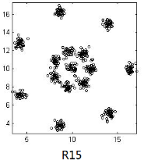
Data Set : R15
Clusters visible because spaced
Strong silhouette influence
Easy to detect errors
Possibility to check
<numéro>

Slide 3
Summary
Expectation
Algorithms
K-means (Lloyd - MacQueen)
Optics
DBSCAN
Quality measures and interpretations
E-commerce dataset
Graph
Quality measures
Conclusion
<numéro>

Slide 4
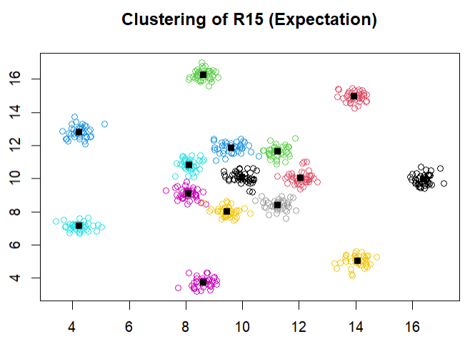
Expectation graph
15 balanced clusters
<numéro>

Slide 5
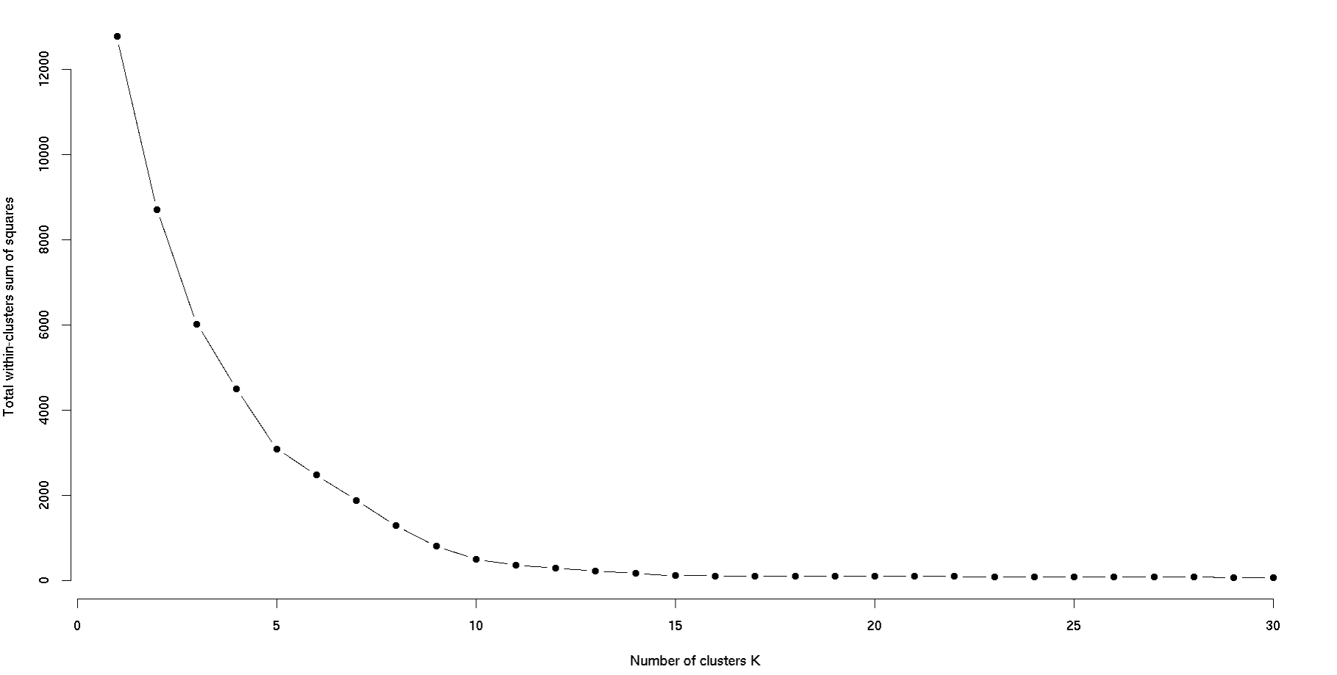
K-Elbow Method
<numéro>

Slide 6
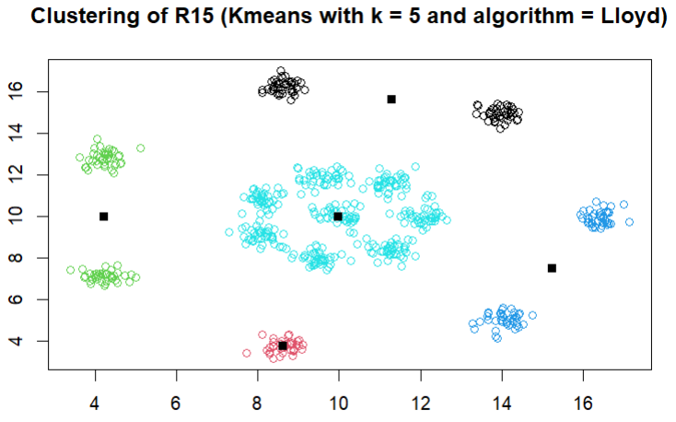
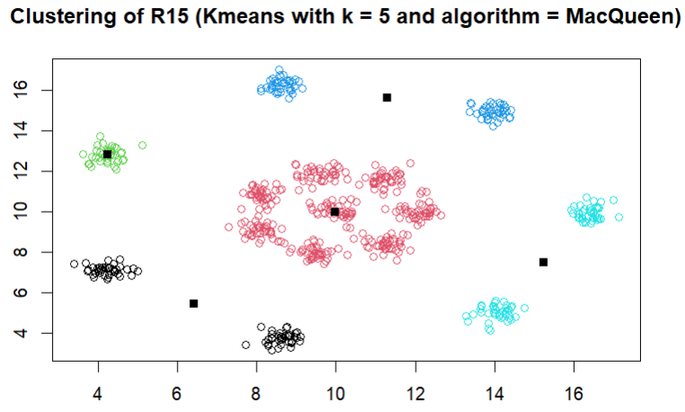
K-means k = 5
Parameters
Iteration number : 100 Start number : 5 Algorithm : Lloyd / MacQueen
<numéro>

Slide 7
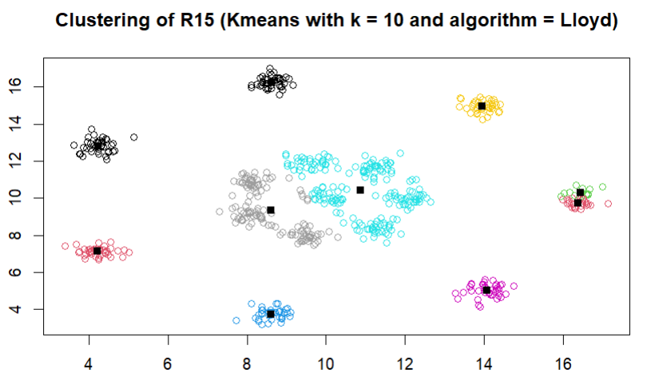
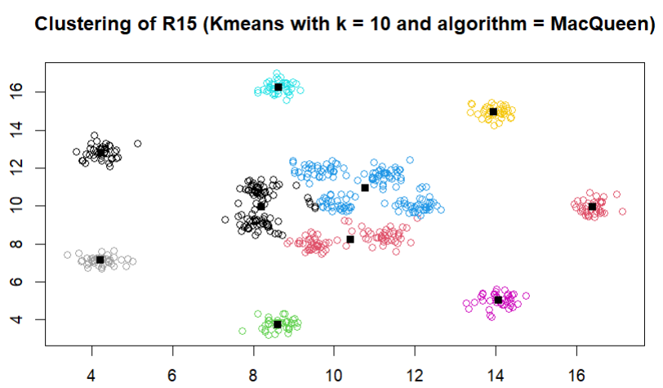
K-means k = 10
Parameters
Iteration number : 100 Start number : 5 Algorithm : Lloyd / MacQueen
<numéro>

Slide 8
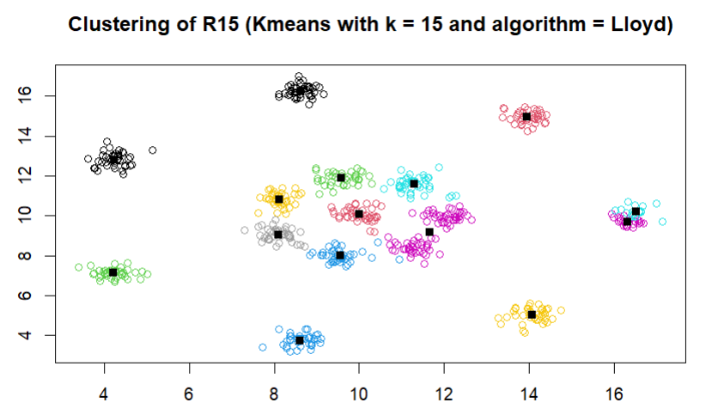
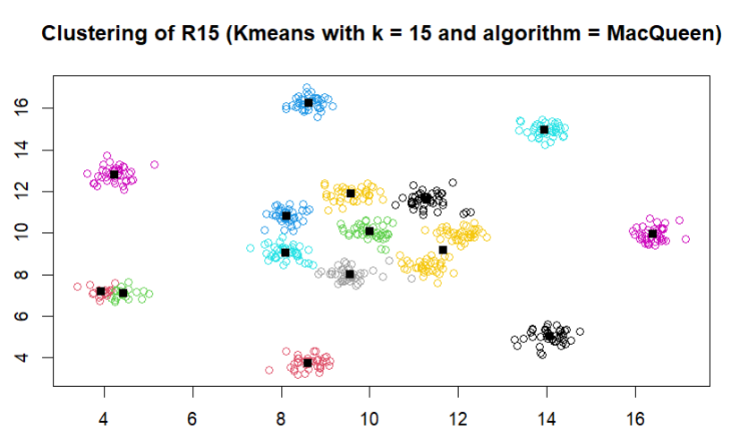
K-means k = 15
Parameters
Iteration number : 100 Start number : 5 Algorithm : Lloyd / MacQueen
<numéro>

Slide 9
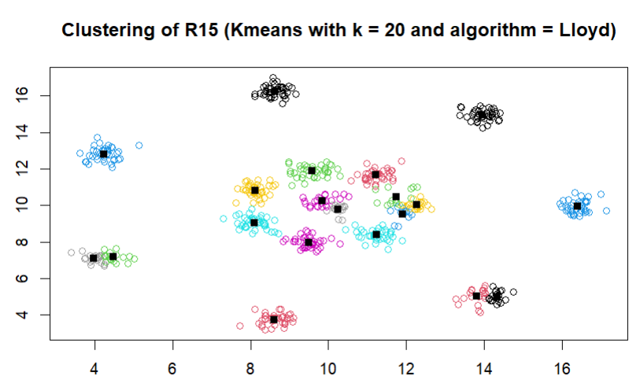
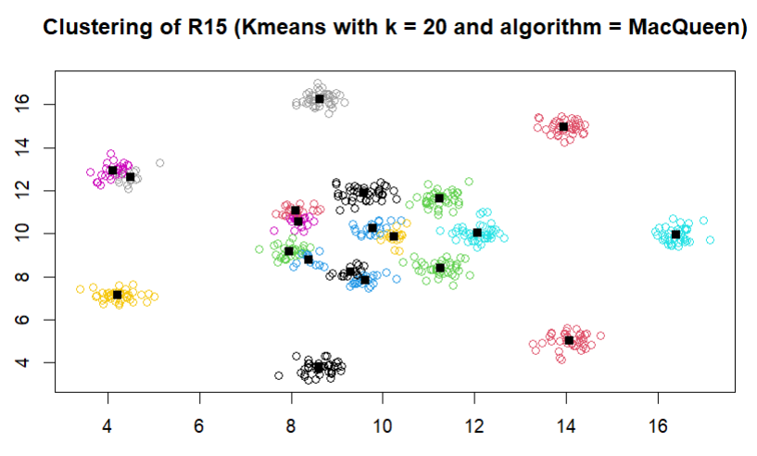
K-means k = 20
Parameters
Iteration number : 100 Start number : 5 Algorithm : Lloyd / MacQueen
<numéro>

Slide 10
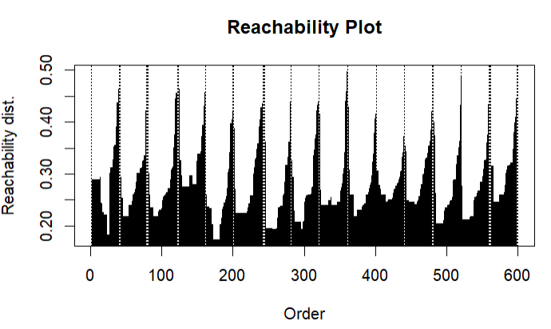
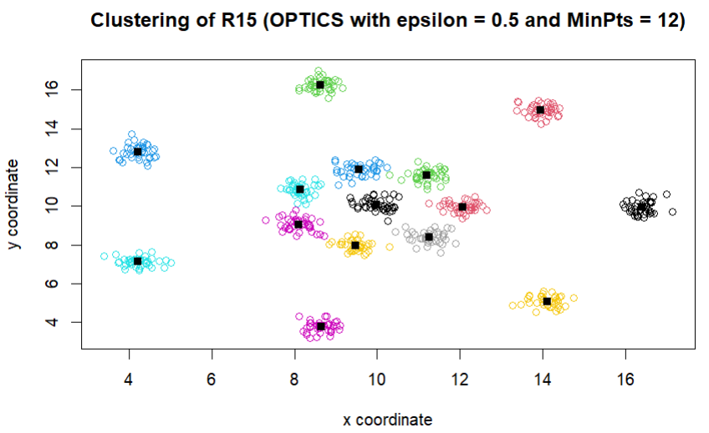
OPTICS epsilon = 0.5 MinPts = 12
15 clusters
<numéro>

Slide 11
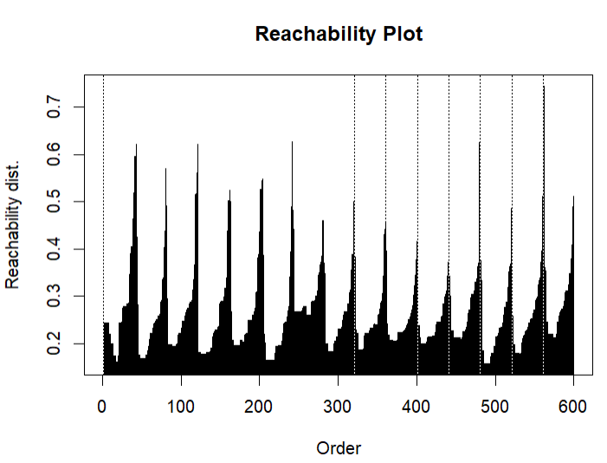
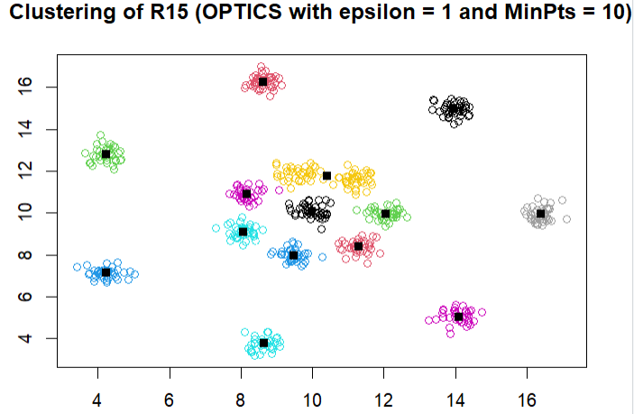
OPTICS epsilon = 1 MinPts = 10
15 clusters
<numéro>

Slide 12
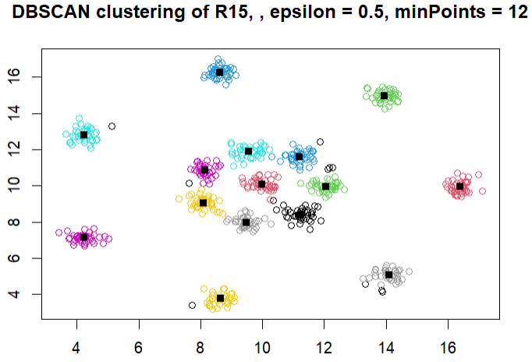
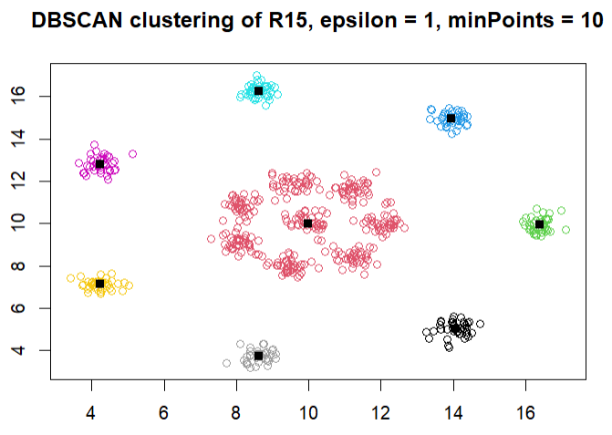
DBSCAN
15 clusters
8 clusters
<numéro>

Slide 13
K-means Quality measures
 | Llyod |  |  |  | MacQueen
K value | k = 5 | k = 10 | k = 15 | k =20 | k = 5 | k = 10 | k = 15 | k =20
silhouette | 0.988 | 0.987 | 0.995 | 0.996 | 0.988 | 0.987 | 0.995 | 0.997
efficiency | 0.756 | 0.934 | 0.988 | 0.992 | 0.757 | 0.961 | 0.988 | 0.993
TD² | 3120 | 506 | 157 | 96 | 3109 | 504 | 156 | 93
possible empty clusters
Efficiency : TD² cluster / TD²
-> kmeans_model$betweenss/kmeans_model$totss
<numéro>

Slide 14
OPTICS Quality measures
Parameters | ε = 0,5, MinPts = 12 | ε = 1, MinPts = 10
Noise Points | 13 | 18
silhouette | 0.97 | 0.97
TD² | 98 | 148
<numéro>

Slide 15
DBSCAN Quality measures
Parameters | ε = 0,5, MinPts = 12 | ε = 1, MinPts = 10
Noise Points | 11 | 0
silhouette | 0.98 | 0.99
TD² | 99 | 1279
<numéro>

Slide 16
Experimental Results
Most suitable for the dataset : DBSCAN
Most unstable in terms of quality achieved when changing parameters : K-means
Quality measures fit to the structure in the dataset : TD²
Some quality measures have a systematic preference for some of the algorithms : TD²
<numéro>

Slide 17
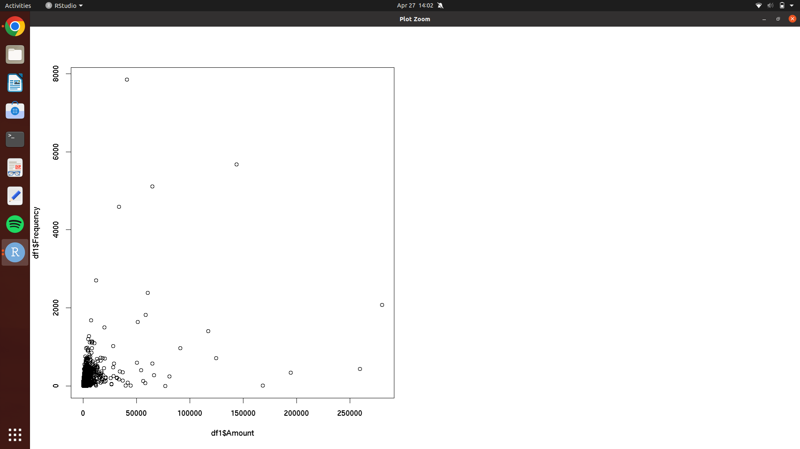
E-commerce dataset
<numéro>

Slide 18
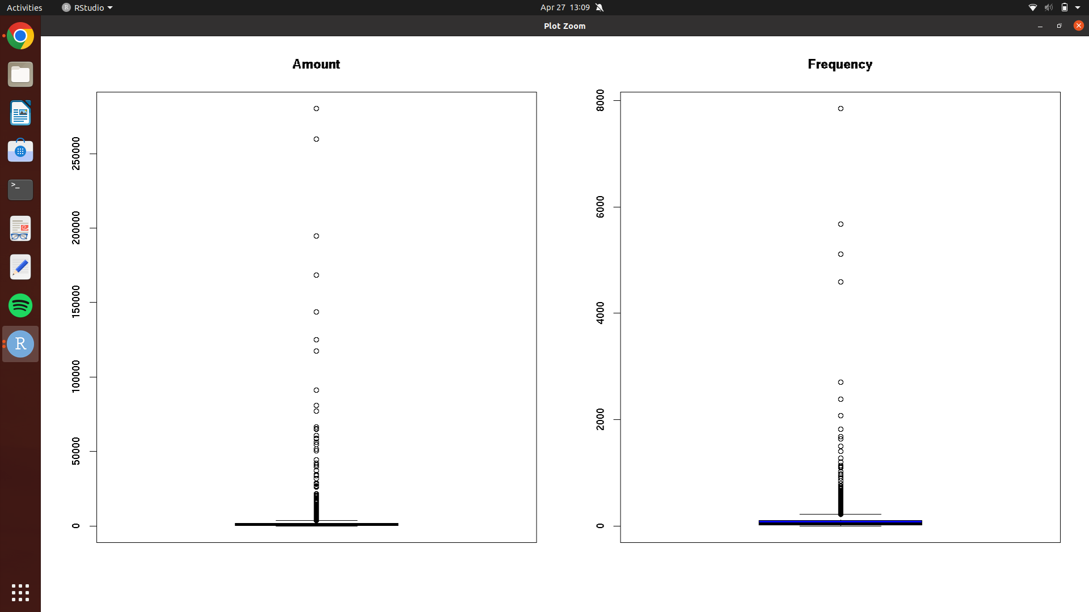
Boxplots
<numéro>

Slide 19
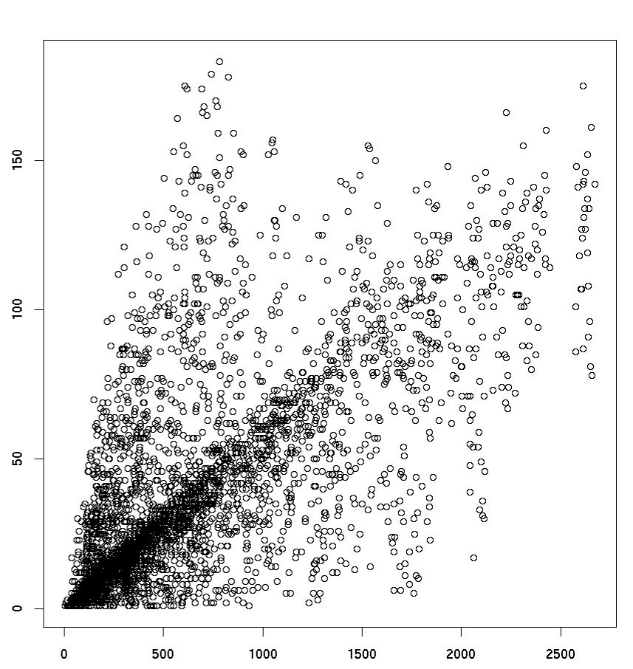
E-commerce dataset without outliers
<numéro>

Slide 20
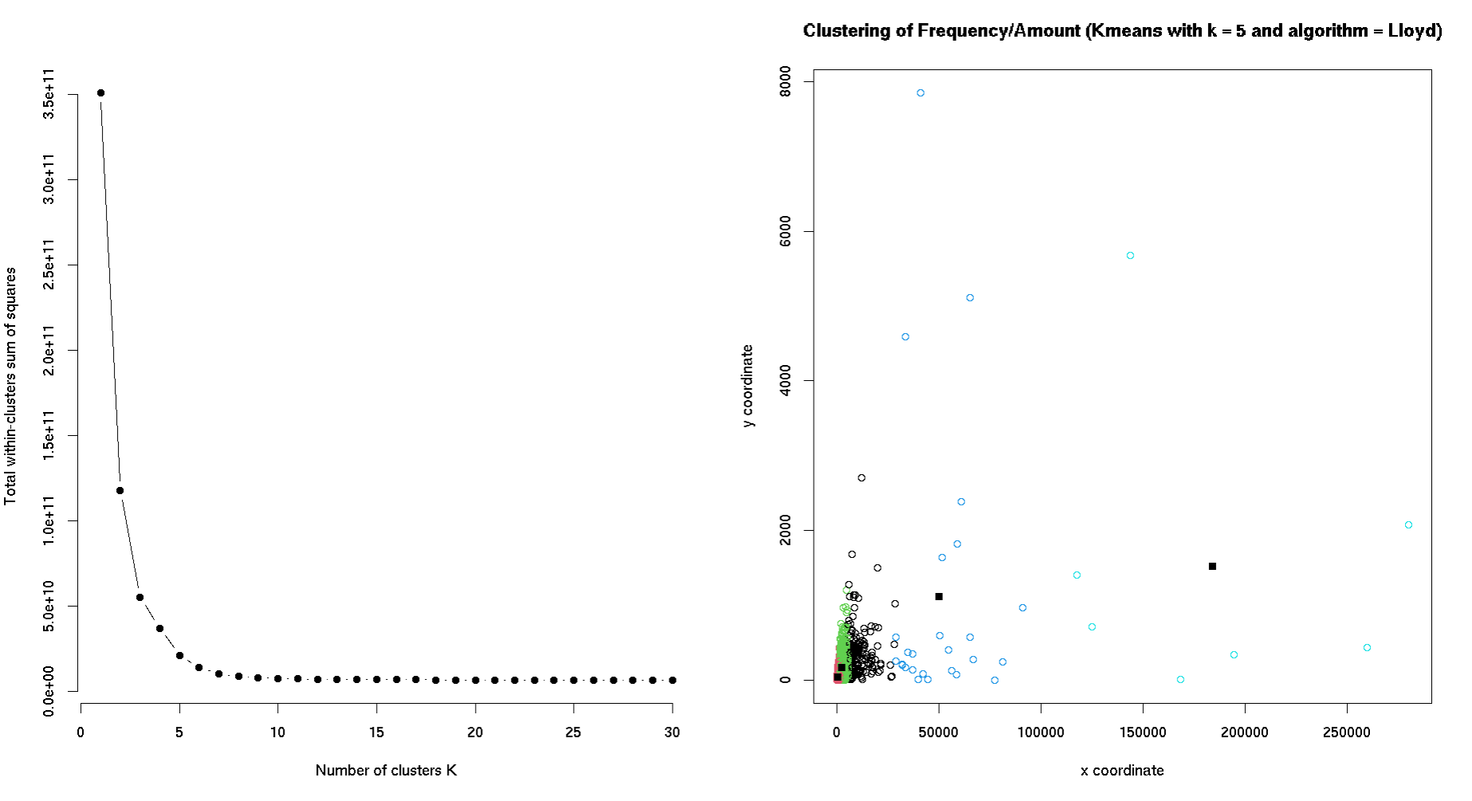
K-elbow method and K-means with k = 5 with outliers
<numéro>

Slide 21
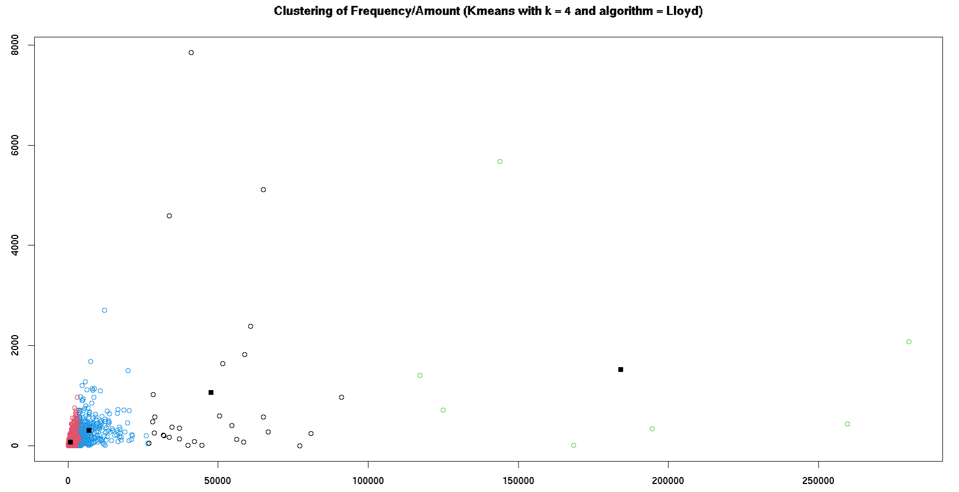
K-means with k = 4
<numéro>

Slide 22
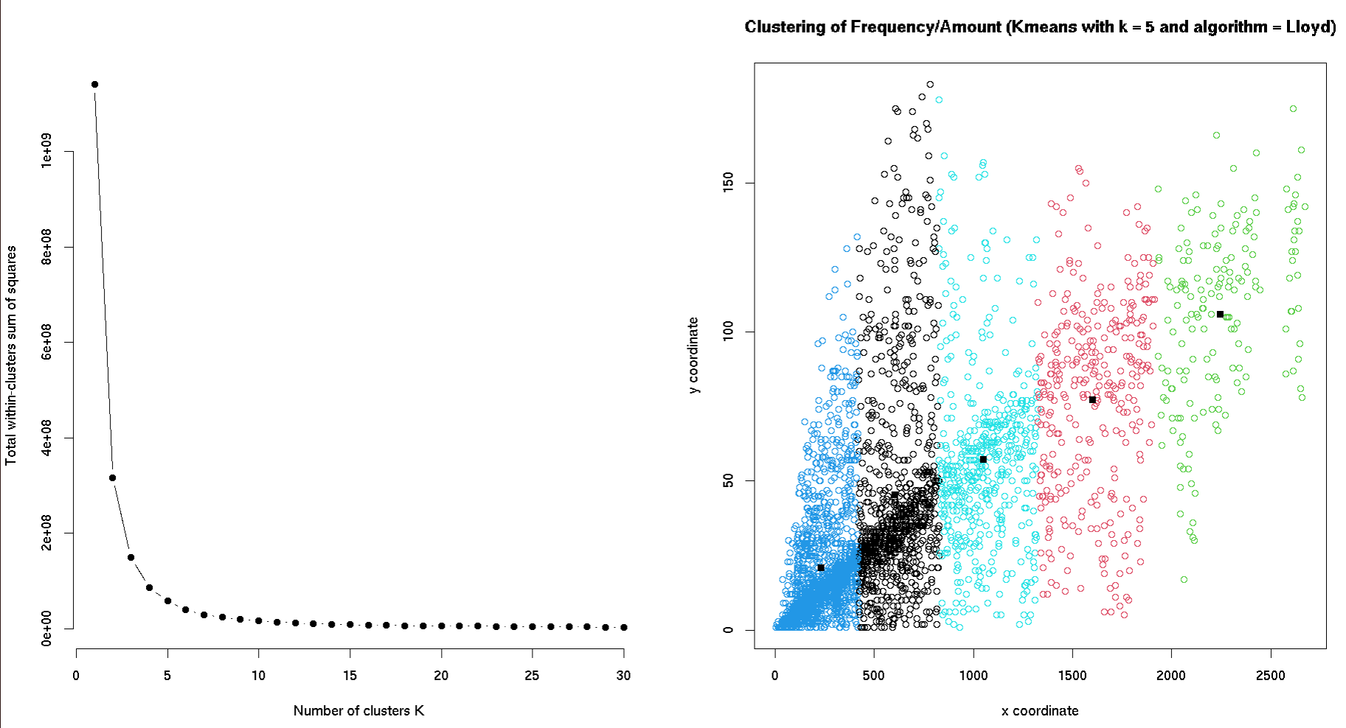
K-elbow method and K-means with k = 5 without the outliers
<numéro>

Slide 23
K-means Quality measures
Outliers | yes | yes | no
Parameter | k = 4 | k = 5 | k = 5
silhouette | 0.44 | 0.62 | 0.83
efficiency | 0.88 | 0.89 | 0.95
TD² | 4 x 10¹⁰ | 4 x 10¹⁰ | 2 x 10¹¹
<numéro>

Slide 24
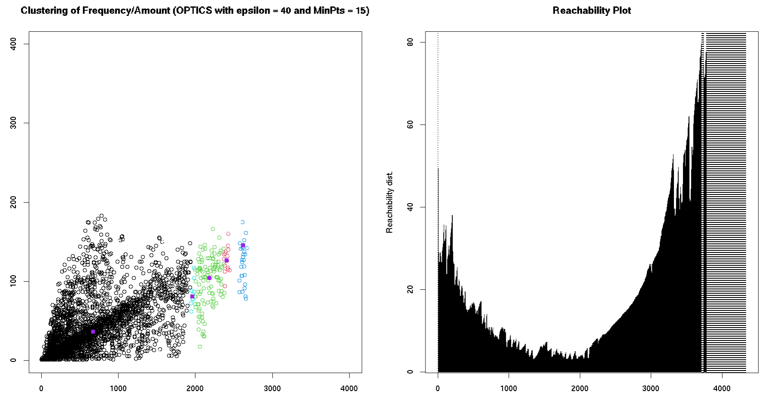
OPTICS Clustering with epsilon = 40 and MinPoints = 15 Outliers
<numéro>

Slide 25
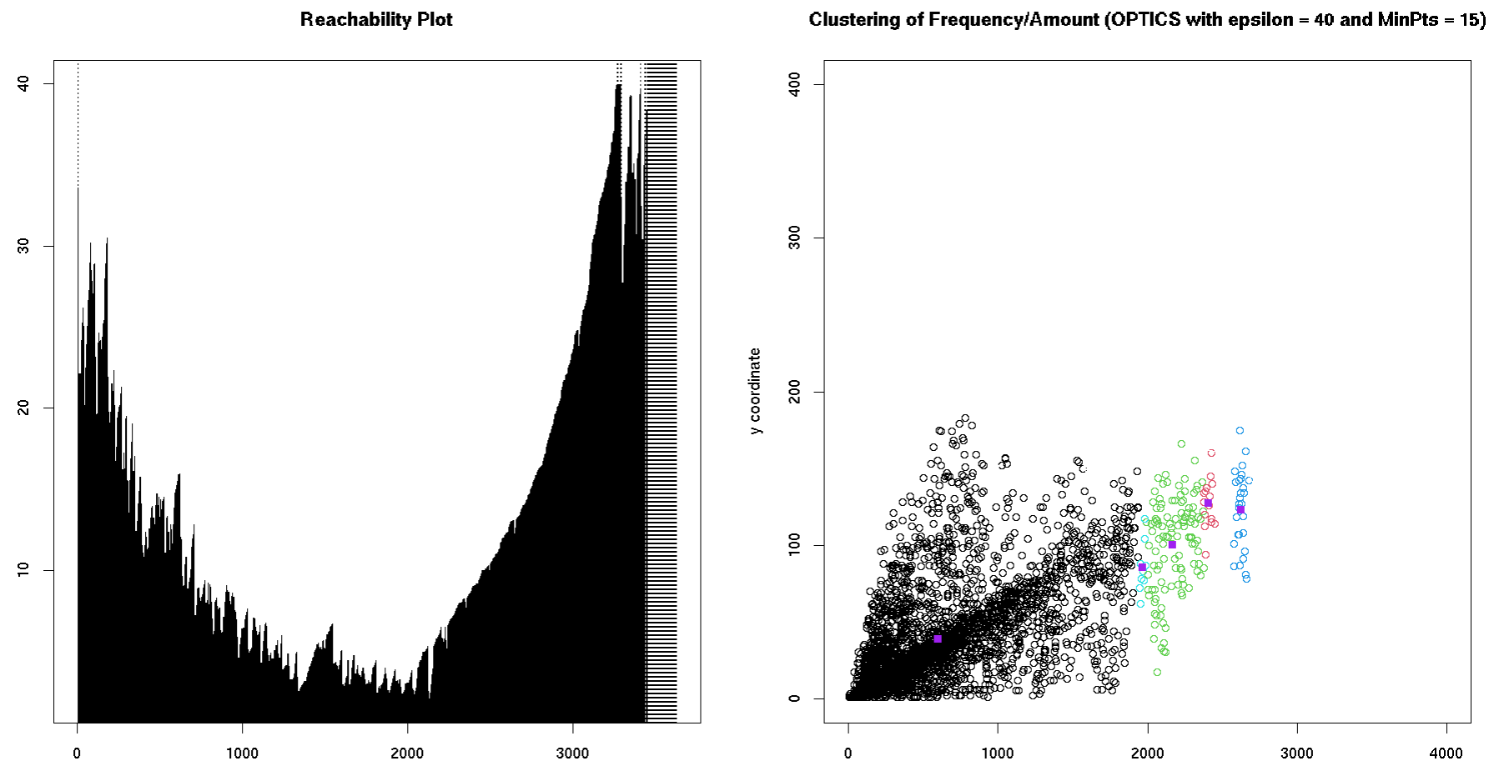
OPTICS Clustering with epsilon = 40 and MinPoints = 15 No outliers
<numéro>

Slide 26
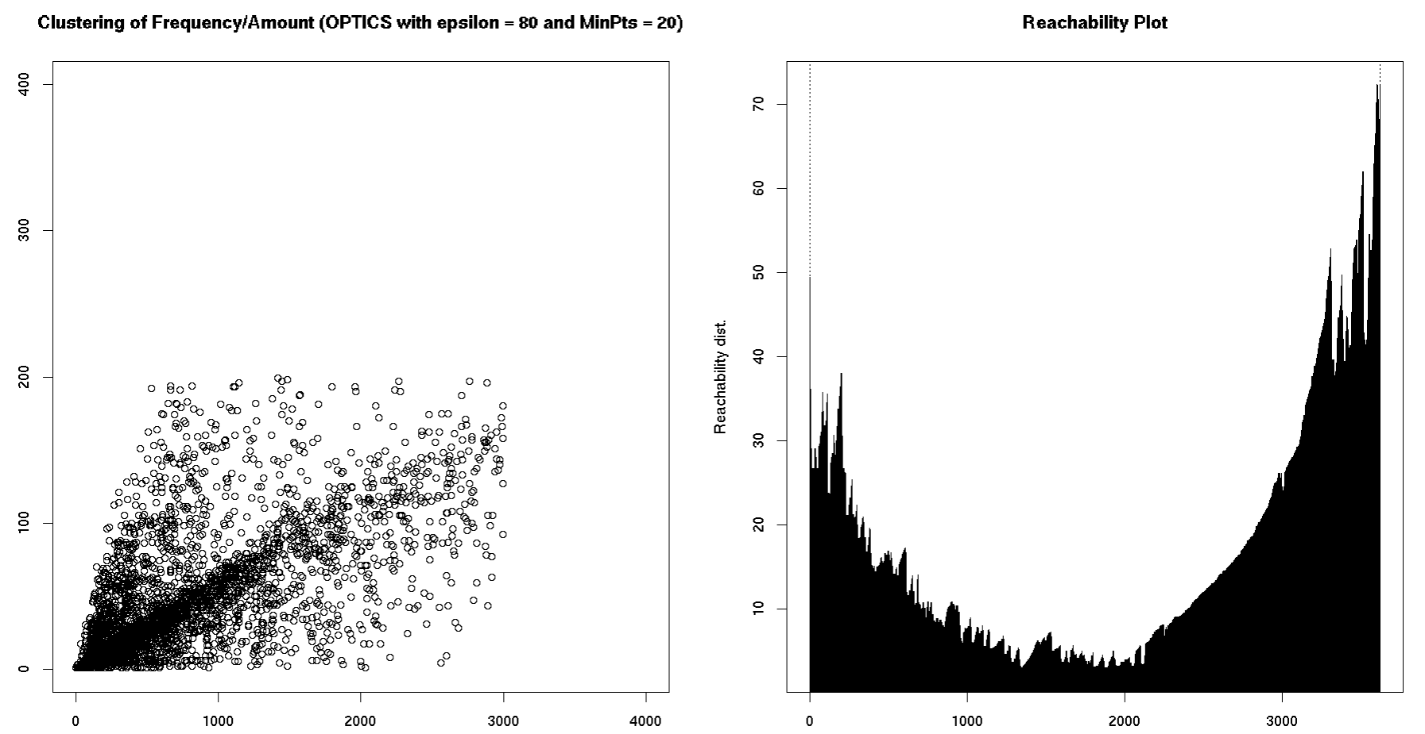
OPTICS Clustering with epsilon = 80 and MinPoints = 20 No outliers
<numéro>

Slide 27
OPTICS Quality measures
Outliers | yes | no | no
Parameters | ε = 40, MinPts = 15 | ε = 80, MinPts = 20 | ε = 40, MinPts = 15
Noise Points | 906 ~ 21% | 1 ~ 0% | 194 ~ 5%
Silhouette | 0.55 | 0.58 | 0.62
TD² | 4 x 10¹⁰ | 2 x 10⁹ | 7 x 10⁸
<numéro>

Slide 28
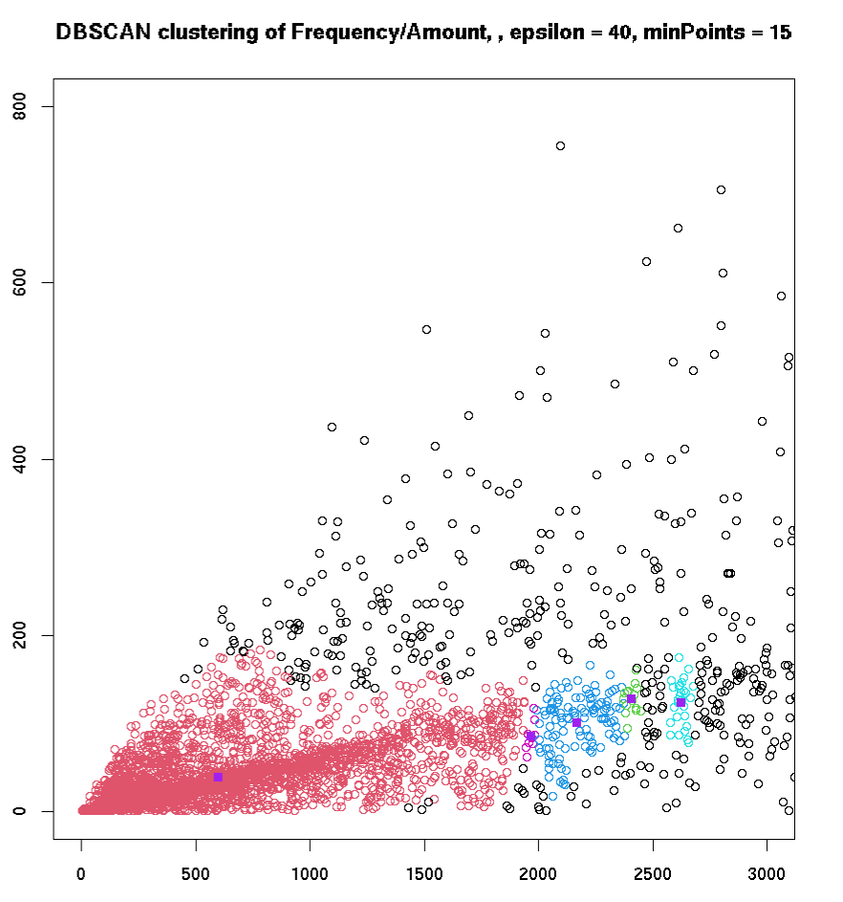
DBSCAN Clustering with epsilon = 40 and MinPoints = 15 Outliers
<numéro>

Slide 29
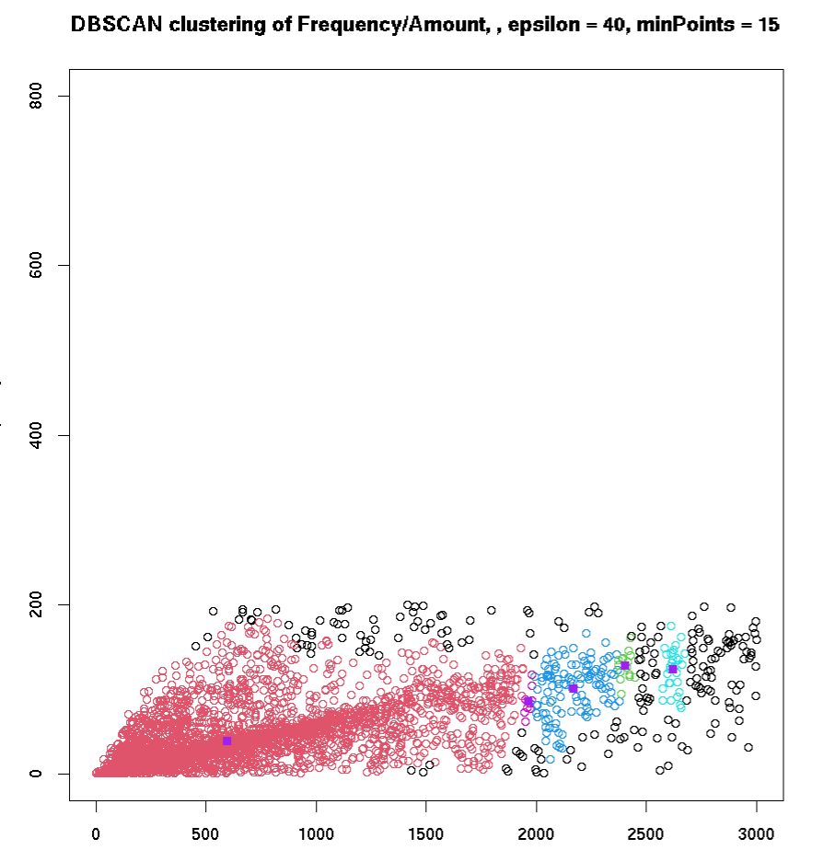
DBSCAN Clustering with epsilon = 40 and MinPoints = 15 No outliers
<numéro>

Slide 30
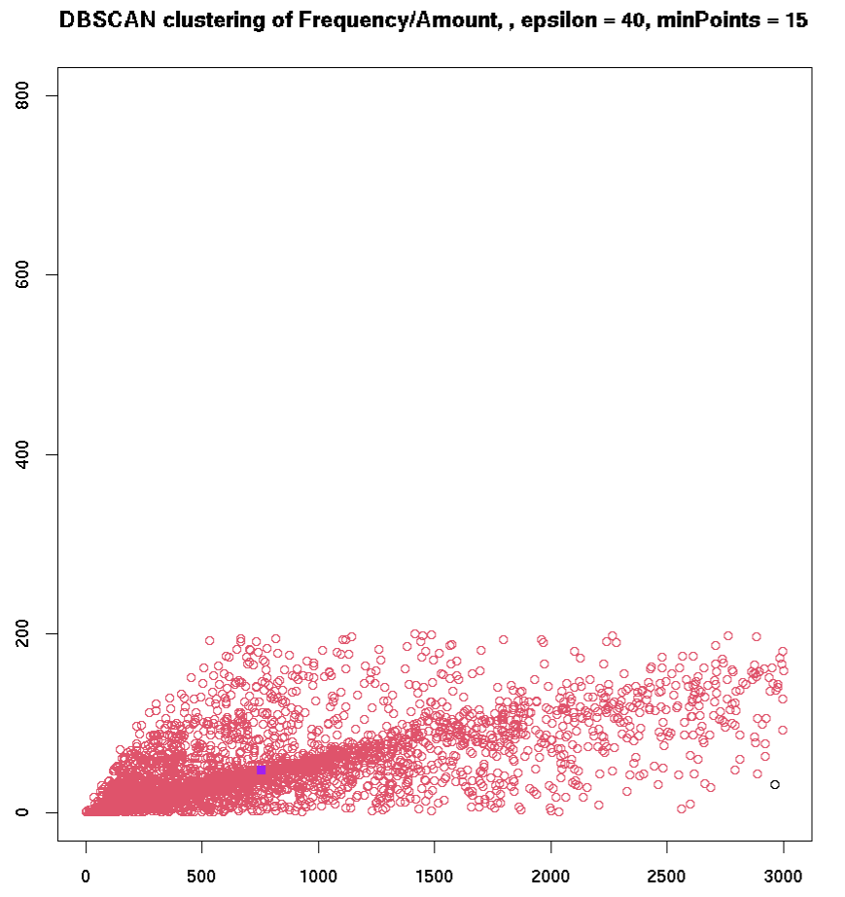
DBSCAN Clustering with epsilon = 80 and MinPoints = 20 No outliers
<numéro>

Slide 31
DBSCAN Quality measures
Outliers | yes | no | no
Parameters | ε = 40, MinPts = 15 | ε = 80, MinPts = 20 | ε = 40, MinPts = 15
Noise Points | 906 ~ 21% | 1 ~ 0% | 191 ~ 5%
silhouette | 0.56 | 0.54 | 0.62
TD² | 7 x 10⁸ | 2 x 10⁹ | 7 x 10⁸
<numéro>

Slide 32
Conclusion
Outliers?
Concrete case
Interpretation?
<numéro>

Slide 33
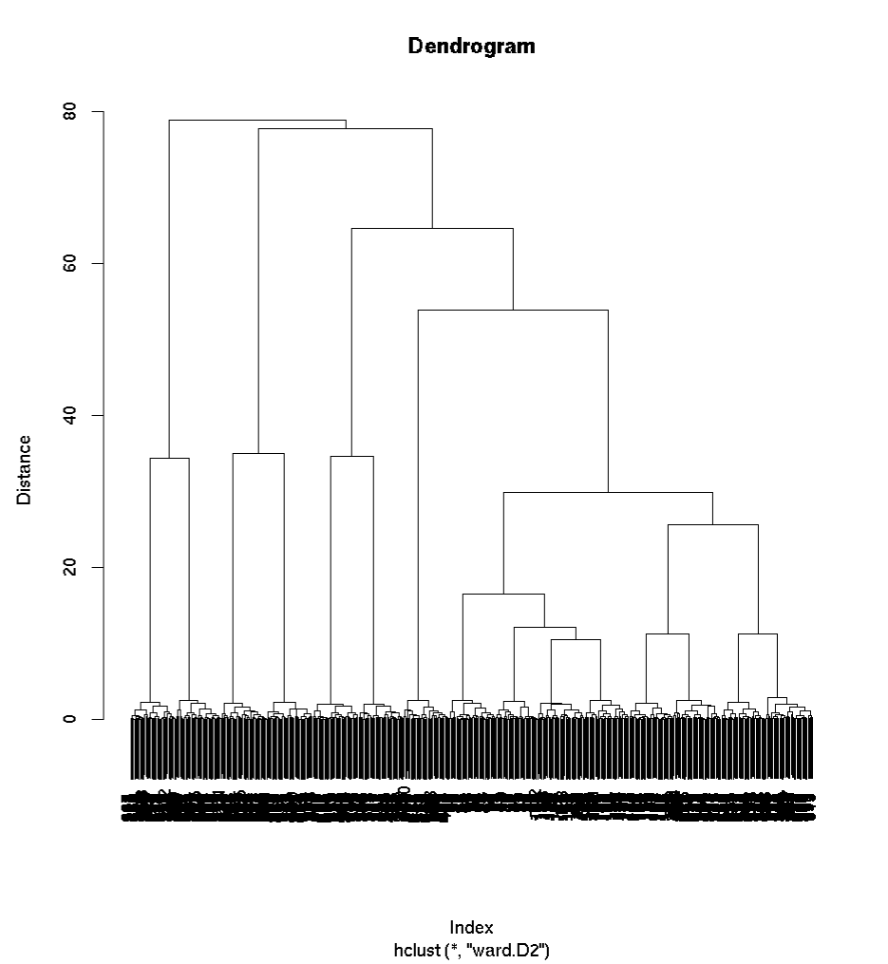
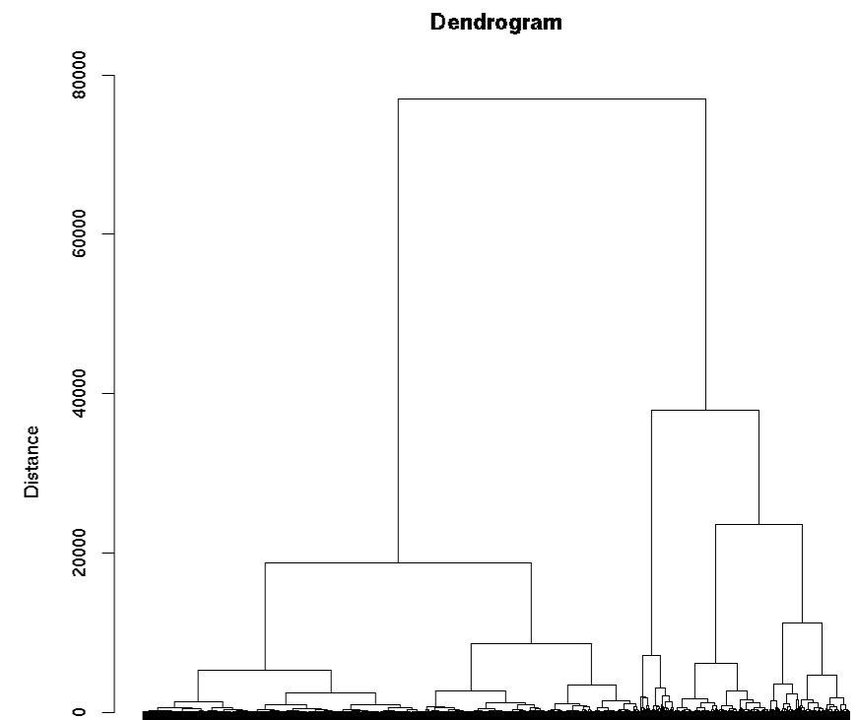
Annex
R15 E-commerce

